Slide 1
Next level Docker
Training

Slide 2
Agenda
https://docs.google.com/document/d/1p0xZ5nDi8_Yz-OgY8gut9rOgdfZcA5M8/edit?usp=sharing&ouid=108972485768906927376&rtpof=true&sd=true

Slide 3
Training Format
Concepts
Hands-on exercises
Assignments
Interactive

Slide 4
Timing
Start time at 9 am
Break 11 am
Lunch 1pm to 2pm
Break 3.30 pm
End at 5 pm

Slide 5
What is Generative AI?
AI systems that generate new content
Text generation (LLMs)
Code generation (Code models)
Image & video generation (Diffusion models)
Multimodal generation (Text + Image)
Driven by deep neural networks (Transformers)

Slide 6
How Large Language Models Work
Based on Transformer architecture
Text → Tokenization → Numerical vectors
Predict next token probabilistically
Context window determines memory limit
Temperature controls randomness
Stateless unless memory is added externally

Slide 7
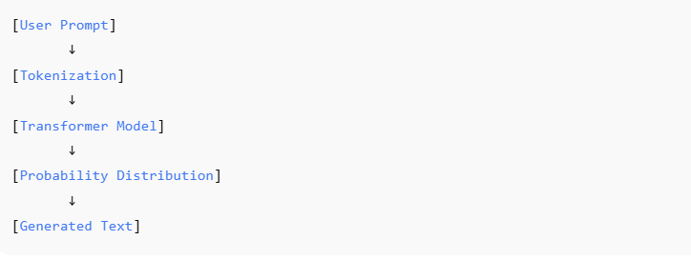
How Large Language Models Work

Slide 8
Hosted vs Local Models
Hosted: OpenAI, Anthropic, Azure OpenAI
Local: Phi-2, Mistral, LLaVA
Hosted requires internet & API key
Local requires CPU/GPU resources
Model size affects RAM & GPU usage
Containerized models improve portability

Slide 9
What is an AI Agent?
LLM + Tools + Memory + Reasoning loop
Operates autonomously toward a goal
Can execute code or call APIs
Maintains state across interactions
Uses iterative Observe → Think → Act loop
More powerful than prompt-based systems

Slide 10
Agent Execution Flow
User Goal
LLM interprets objective
Agent selects tool or action
Executes action (code/API)
Observes result
Refines plan and repeats

Slide 11
Agent Architecture Components
LLM Brain
Tool interface (CLI/APIs)
Memory (Vector DB / Context)
Planner / Reasoning loop
Execution environment (Container)
Security & monitoring layer

Slide 12
Deterministic vs Agentic Workflows
Deterministic: Fixed step pipelines
Agentic: LLM dynamically decides steps
Supports branching logic
Handles unexpected outcomes
Requires orchestration engine
Foundation for intelligent automation

Slide 13
Why Containers are Critical in GenAI
Isolate model dependencies
Avoid GPU/CUDA conflicts
Run untrusted AI-generated code safely
Ensure reproducibility
Enable CI/CD integration
Improve deployment portability

Slide 14
LLM Execution Patterns
API-based inference
Local embedded inference
Containerized model runtime
Model Runner approach
Supports CPU & GPU execution
Improves security and scalability

Slide 15
Workflow as Code Philosophy
Pipelines defined in Python or Go
Version-controlled workflows
Testable & reproducible
Declarative definitions
Reusable components
Used in Dagger pipelines

Slide 16
Declarative vs Imperative Thinking
Imperative: Step-by-step instructions
Declarative: Describe desired outcome
Engine resolves execution plan
Better for distributed systems
Supports modular composition
Key mindset for workflow tools

Slide 17
Security Risks in Agentic Systems
Prompt injection attacks
Arbitrary code execution risk
Data leakage vulnerabilities
Resource exhaustion (GPU abuse)
Dependency supply chain risks
Container isolation reduces risk

Slide 18
GenAI Infrastructure Stack
Application Layer
Agent Layer
Workflow Layer (Dagger)
Container Layer (Docker)
Model Runtime Layer
Hardware Layer (CPU/GPU)

Slide 19
Module 5: Agentic Workflow Composition with Dagger
Understand Dagger and Workflows as Code philosophy
Use Python or Go SDKs for declarative pipelines
Configure LLM and container runs inside workflows
Build reproducible and secure AI execution pipelines
Compose agentic multi-step workflows
Integrate DevOps + AI automation patterns

Slide 20
What is Dagger?
Open-source programmable CI/CD and workflow engine
Implements Workflows as Code philosophy
Pipelines written in Go, Python, TypeScript
Runs tasks inside ephemeral containers
Portable and cloud-native execution
Built on BuildKit backend

Slide 21
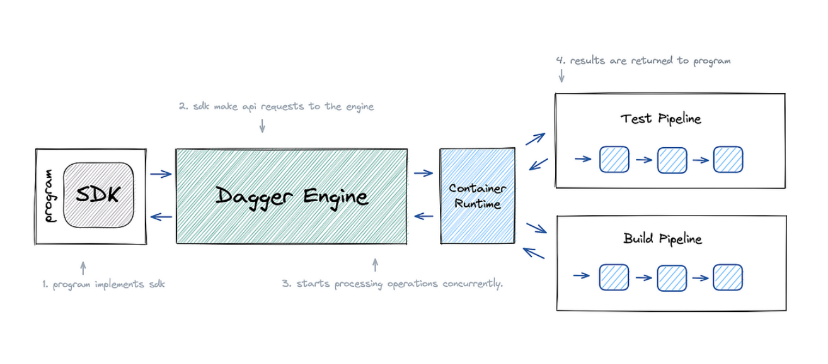
What is Dagger?

Slide 22
Workflows as Code Philosophy
Pipelines defined using real programming languages
Version-controlled and testable
Reusable modular components
Better debugging and IDE support
Eliminates CI vendor lock-in
Infrastructure + AI tasks as programmable graphs

Slide 23
Why Dagger for Agentic AI?
AI agents require code execution and tool usage
Container isolation for safety
Multi-step orchestration support
Deterministic container-based tool runs
Secure automation pipelines
Ideal for AI + DevOps integration

Slide 24
Using Python SDK
Install Dagger Python SDK
Connect to Dagger engine
Define container steps declaratively
Chain steps via object references
Execute workflow asynchronously
Return structured outputs to agents

Slide 25
Using Go SDK
Strong typing for pipeline definitions
Compile-time validation
Reusable production-ready pipelines
Chain containers and services
Enterprise CI/CD integration
High performance and reliability

Slide 26
Running LLMs Inside Dagger Workflows
Run LLM inference containers
Mount dynamic prompt files
Capture structured responses
Chain LLM → Tool → Validation
Secure execution environment
Enable agentic AI automation

Slide 27
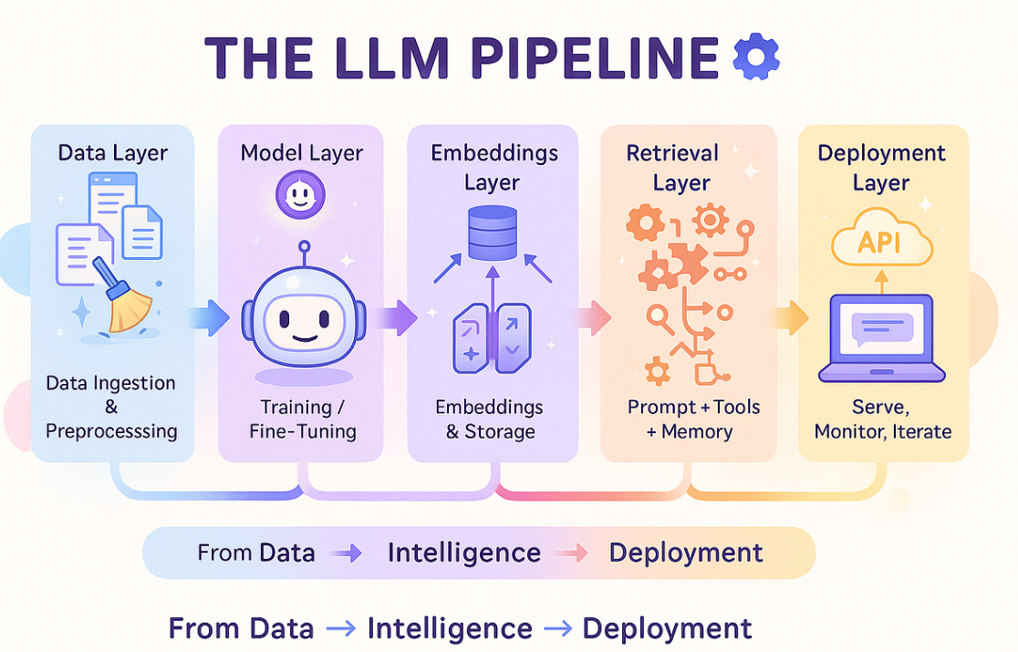

Slide 28
Configuring Container Runs
Pull base images (Python, Node, etc.)
Mount source directories
Inject environment variables securely
Execute commands inside containers
Capture logs and outputs
Use caching for performance

Slide 29
Agentic Workflow Composition Pattern
Planner Agent → Creates task steps
Coder Agent → Generates code
Dagger → Executes in container
Reviewer Agent → Validates output
Executor → Final deployment/action
Deterministic orchestration backbone

Slide 30
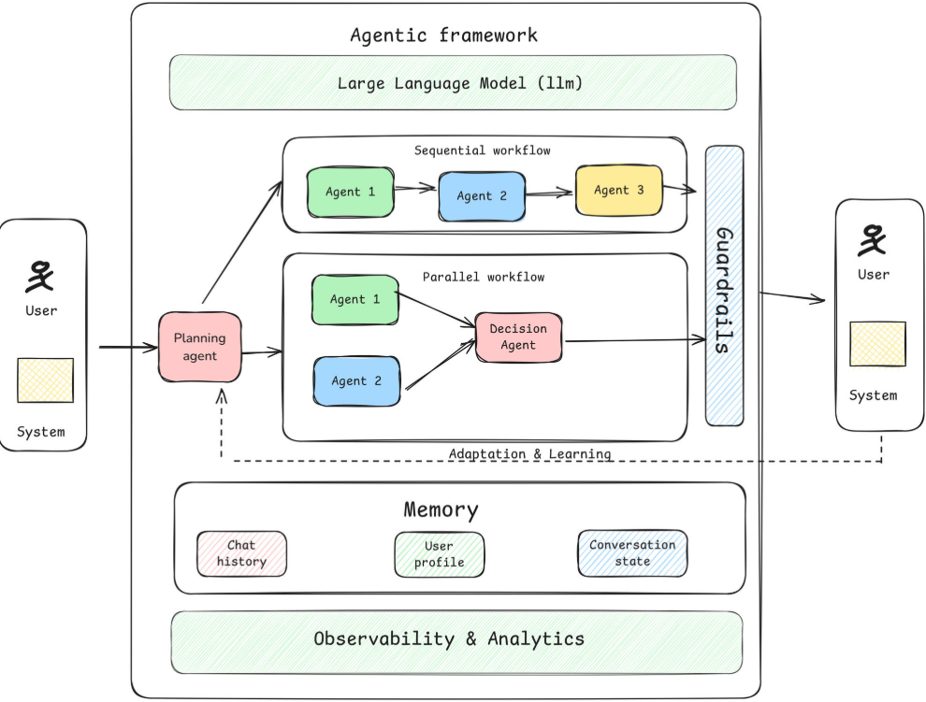

Slide 31
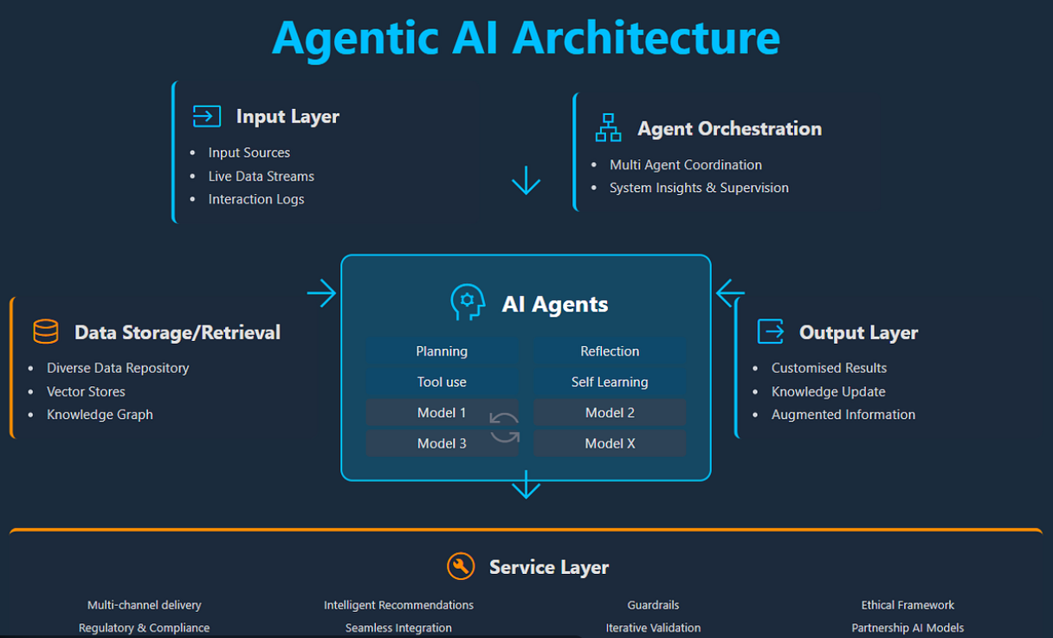

Slide 32
Key Advantages
Reproducible AI tool execution
Secure sandboxing of generated code
Deterministic pipeline runs
Cloud portability
Fully programmable workflows
Production-ready orchestration layer

Slide 33
Module 6: GenAI Containerization with Docker Model Runner
Why containerization matters for AI
Running LLMs using Docker
CPU vs GPU execution
Model compatibility considerations
Production best practices

Slide 34
Why Containerize Generative AI Models?
Eliminates dependency conflicts (Python, CUDA, Transformers)
Ensures reproducible environments
Simplifies cloud & Kubernetes deployment
Enables secure, isolated execution
Supports scalable AI microservices
Reduces environment-related failures

Slide 35
What is Docker Model Runner?
Containerized runtime for AI/ML models
Packages model + dependencies + inference server
Run models using simple docker run command
Exposes REST API for inference
Works locally or in Kubernetes
Supports CPU and GPU modes

Slide 36
Key Use Cases
Local LLM inference without cloud cost
Running multimodal (Vision + Language) models
Secure execution for AI agents
Enterprise deployment (VMs, AKS, etc.)
Model versioning & rollback
CI/CD integration for AI workloads

Slide 37
Running a Language Model (CPU Mode)
Pull inference container image
Specify model ID during startup
Expose API port (e.g., 8080)
Send prompt via HTTP POST
Suitable for experimentation
Ideal for small-scale applications

Slide 38
Running Multimodal Models (GPU Mode)
Requires NVIDIA GPU
Use --gpus all flag
Install NVIDIA container toolkit
Ensure CUDA compatibility
Higher VRAM requirements (7B+ models)
Used for image reasoning & captioning

Slide 39
CPU vs GPU Configuration
CPU: Simple setup, slower inference
GPU: High performance, complex setup
Verify GPU with nvidia-smi
Match CUDA version with driver
Monitor memory usage
Avoid OOM errors

Slide 40
Model Compatibility & Architecture
Check system architecture (x86_64 vs arm64)
Ensure container supports your platform
Validate CUDA compatibility
Consider VRAM before choosing model
Use quantized models if needed
Test performance before production

Slide 41
Production Best Practices
Pin model and container versions
Monitor CPU, GPU, memory usage
Enable logging & observability
Secure APIs with authentication
Scan images for vulnerabilities
Automate deployment with CI/CD

Slide 42
Module 7 Overview – Agentic Workflows Using container-use
Understand the concept of container-use in AI systems
Learn one-shot vs modular workflow patterns
Run AI tools inside isolated container environments
Compose workflows using declarative patterns
Apply production-grade execution architecture
Prepare for advanced multi-agent orchestration systems

Slide 43
Why Agentic Workflows Matter
Traditional scripts are static and sequential
Agentic systems perform reasoning before execution
Support dynamic decision-making and tool selection
Enable multi-step problem solving
Improve automation reliability and scalability
Foundation for autonomous AI systems

Slide 44
What is container-use?
Execution of tasks inside isolated containers
Provides clean runtime per workflow step
Prevents host environment contamination
Ensures reproducibility of execution
Supports dependency isolation
Acts as secure sandbox for AI tools

Slide 45
Core Benefits of Isolation
Avoids dependency conflicts across workflows
Improves system security and control
Enables safe execution of generated code
Supports resource limitation (CPU, memory)
Simplifies debugging and reproducibility
Encourages production-grade engineering discipline

Slide 46
One-Shot Workflow Pattern
Single task executed inside one container
Container starts, executes task, then stops
Suitable for simple transformations or analysis
Example: Document summarization
Minimal orchestration required
Low operational complexity

Slide 47
Modular Workflow Pattern
Workflow broken into multiple isolated steps
Each step runs in separate container
Outputs passed between stages
Supports scaling of individual components
Enables reuse of workflow modules
Common in enterprise AI systems

Slide 48
Coding Agents + Container Execution
LLM generates code dynamically
Code executed inside isolated container
Output evaluated by agent
Agent fixes errors and retries
Supports autonomous development loops
Critical for safe AI code execution

Slide 49
Declarative Workflow Composition
Workflow defined as structured configuration
Describes steps instead of hardcoding logic
Improves clarity and maintainability
Enables orchestration engines to interpret flow
Supports versioning of workflows
Encourages reusable execution templates

Slide 50
Example Declarative Structure Concept
Define workflow name and steps
Specify container image per step
Assign execution script or command
Define input-output mapping
Enable logging and monitoring hooks
Allow retry and failure policies

Slide 51
Real-World Applications
AI-powered code review automation
Data preprocessing and ML training pipelines
Document intelligence workflows
Campaign content generation systems
DevOps automation with AI agents
Multi-agent orchestration frameworks

Slide 52
Best Practices for Production Systems
Use minimal and secure base images
Run containers as non-root users
Set CPU and memory constraints
Implement structured logging
Add retry and validation logic
Version-control workflow definitions
Monitor execution metrics

Slide 53
Common Mistakes to Avoid
Running AI-generated code on host machine
Hardcoding workflow logic in scripts
Ignoring failure handling strategies
Not validating container outputs
Overloading single container with all tasks
Skipping security checks and scanning

Slide 54
Advanced Architecture Pattern
Planner agent decomposes task
Tool selector chooses execution step
Container executes tool safely
Evaluator checks output quality
Retry loop handles errors automatically
Results aggregated and returned
Forms base of autonomous AI platforms

Slide 55
Module Summary – Key Takeaways
Container-use enables safe AI execution
Isolation is critical for production systems
One-shot and modular patterns serve different needs
Declarative workflows improve scalability
Agents + containers enable autonomous loops
Foundation for enterprise-grade GenAI systems

